Slide 1
UK’s Used Cars Case Study: From Multivariant Data Analysis to
Predictive Modeling
Soukaïna Mahboub Mehboub
ADEI Q1 2023
FIB - UPC

Slide 2
Introduction
WHAT IS OUR DATA?
A 5,000 sample from a 100,000 UK used car dataset.
WHAT IS OUR GOAL?
Analyse our data to build good forecasting models
STEPS TO FOLLOW
EDA & Data Quality
Imputation & Profiling
PCA & CA & MCA
Clustering
Forecasting Modelling
Source of the dataset: https://www.kaggle.com/adityadesai13/used-car-dataset-ford-and-mercedes

Slide 3
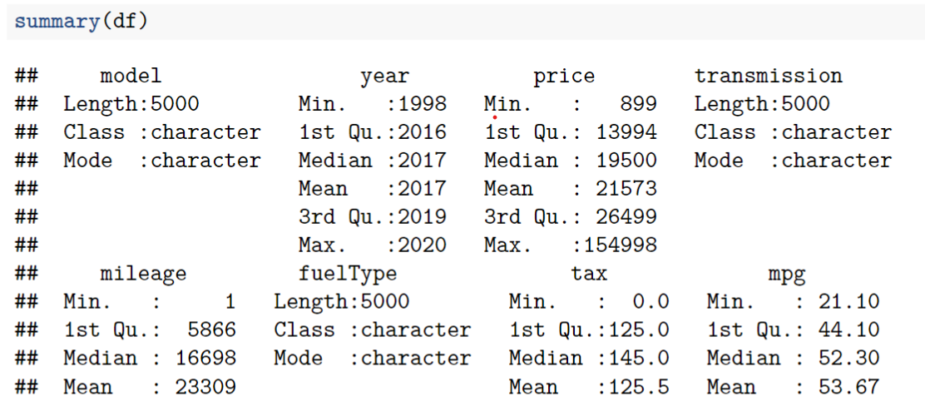
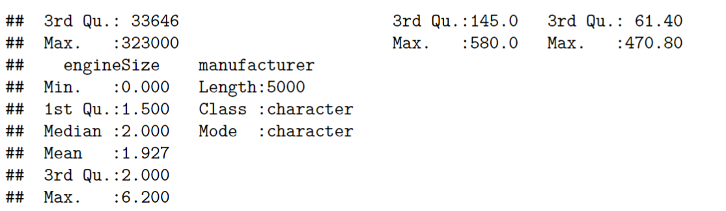
Data Set Overview

Slide 4
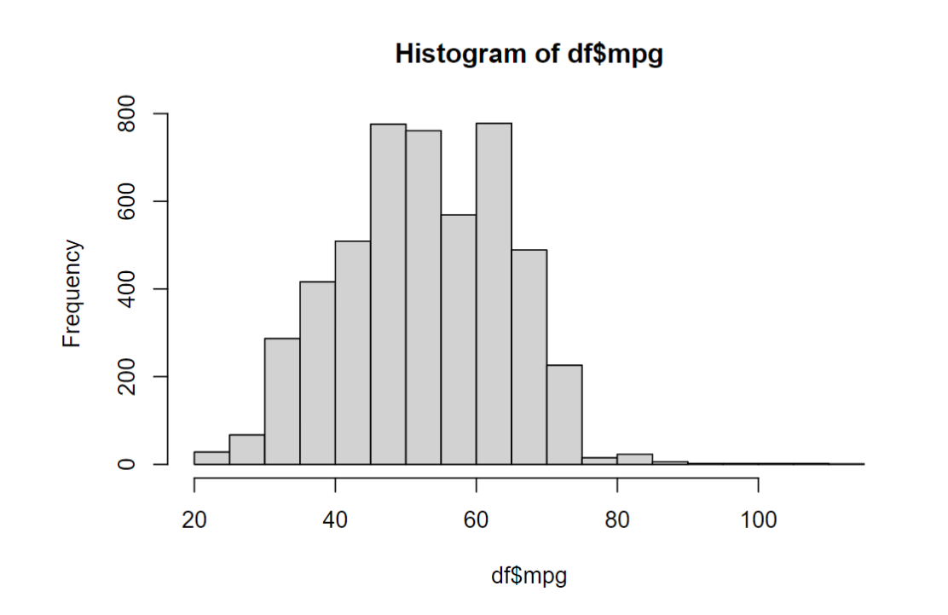
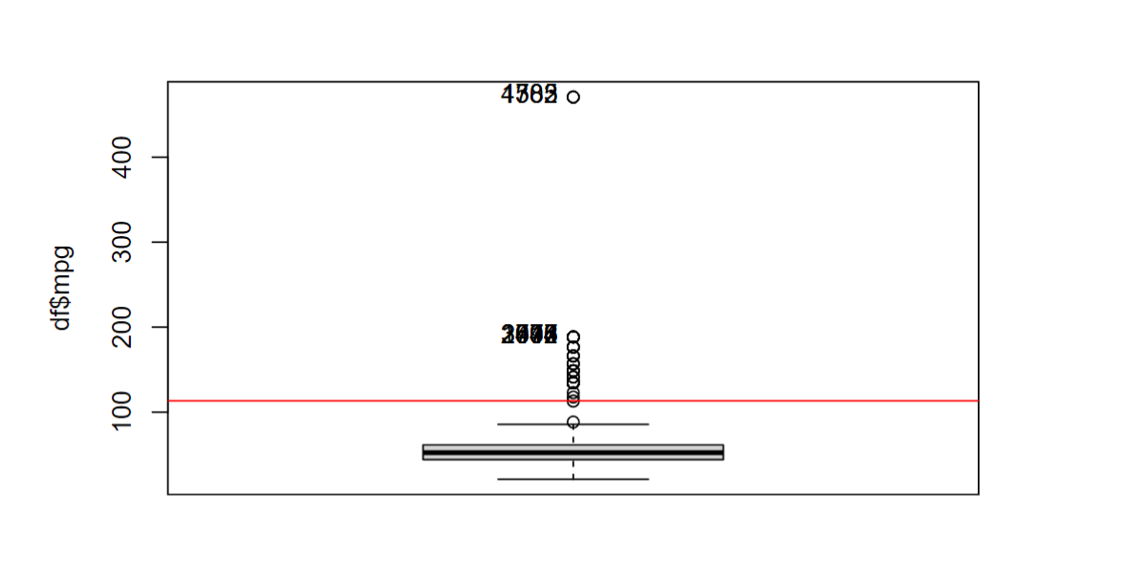
Exploratory Data Analysis & Data Quality
Factorization
Missings
Errors
Outliers
Multivariant Outliers

Slide 5
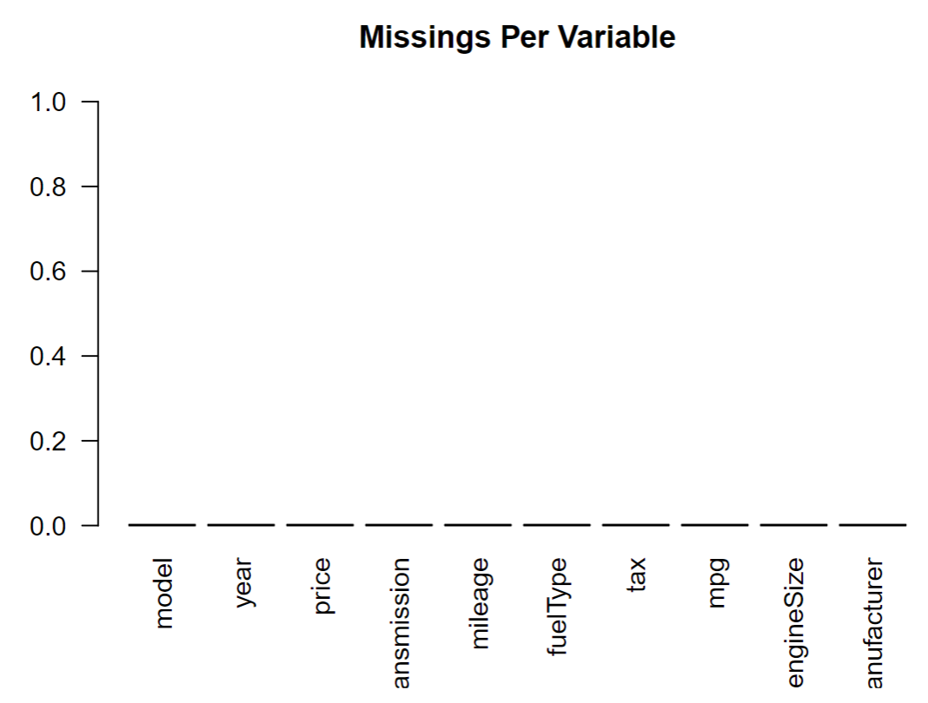
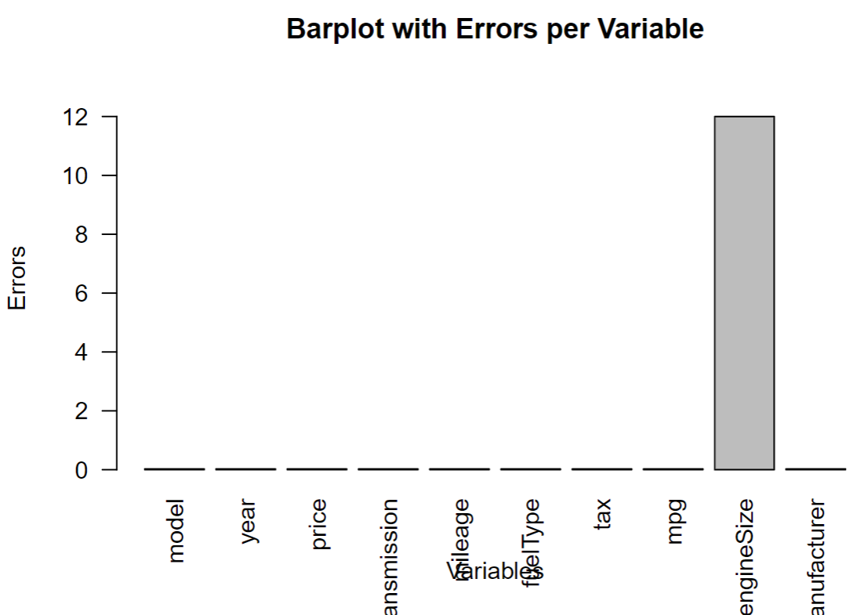
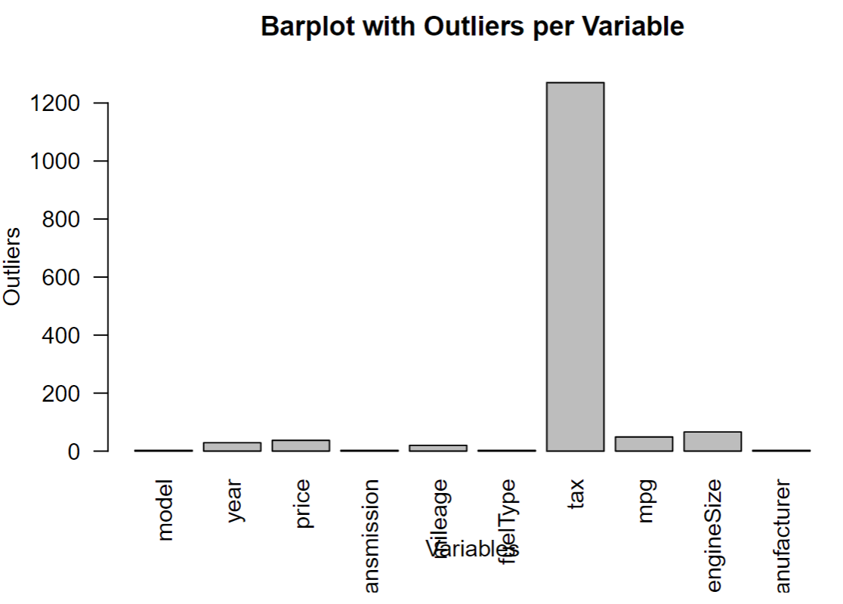
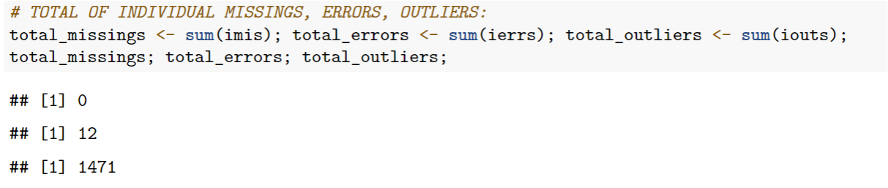
Summary

Slide 6
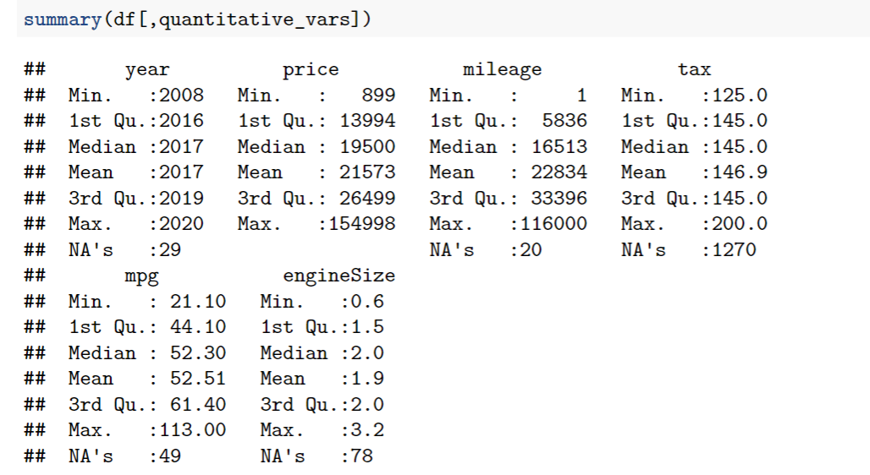
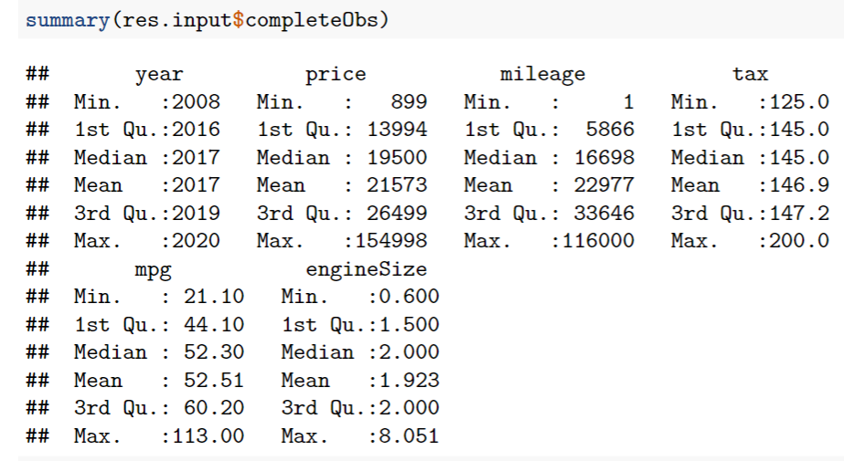
IMPUTATION
For numerical variables using inputPCA
Same for categorical variables using inputMCA

Slide 7
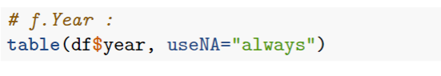
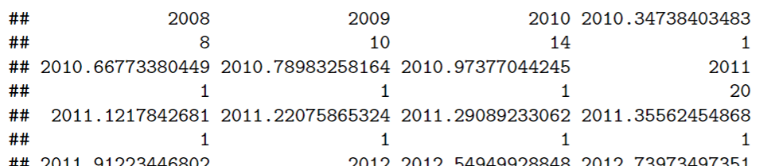
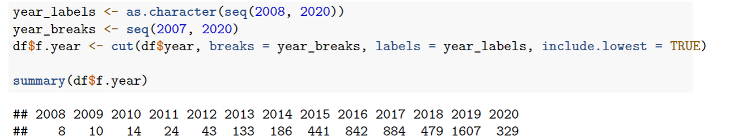
DISCRETISATION

Slide 8
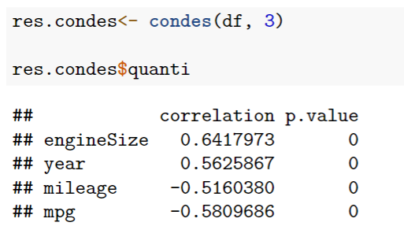
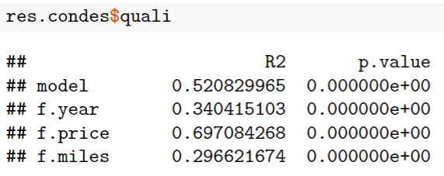
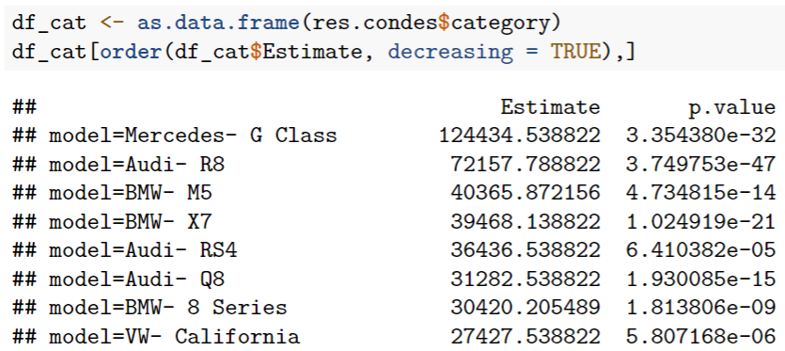
Profiling with Price

Slide 9
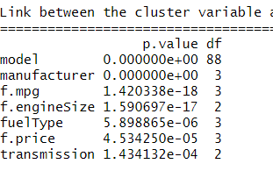
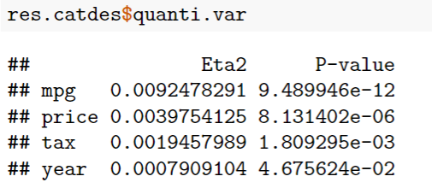
Profiling with Audi

Slide 10
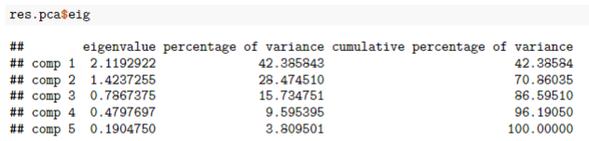
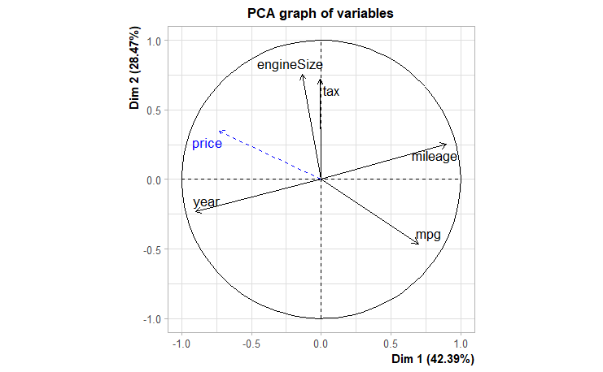
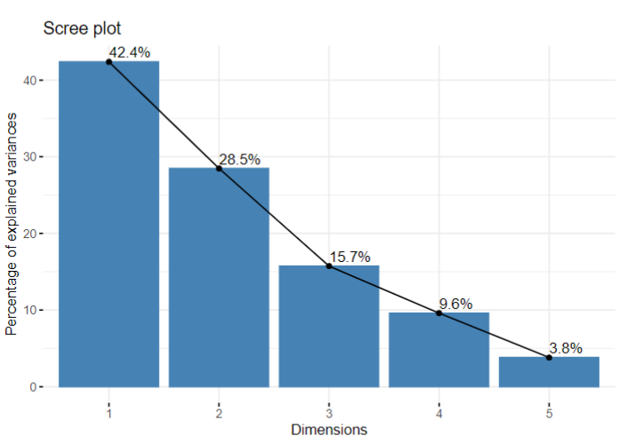
PCA

Slide 11
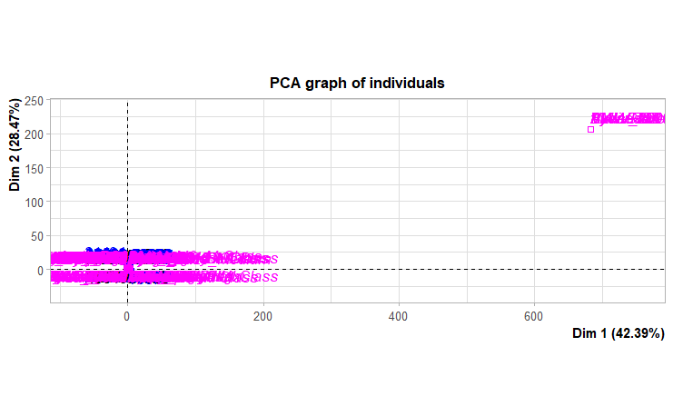
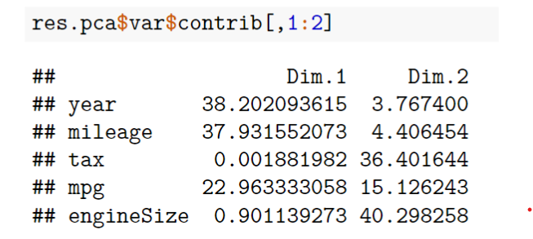

Slide 12
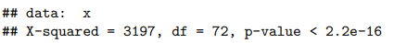
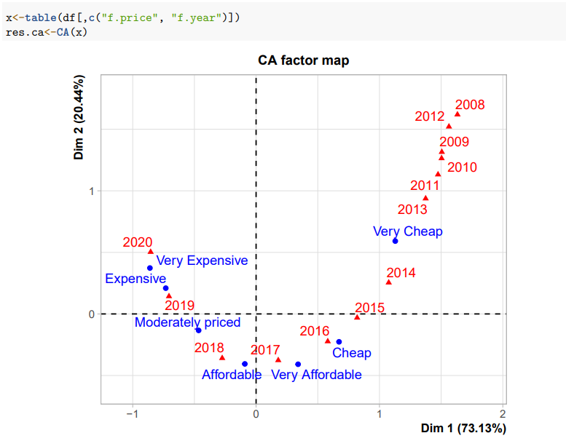
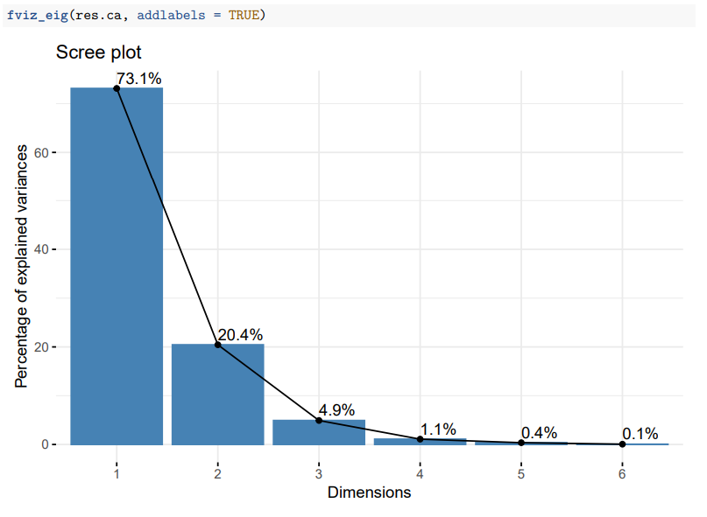
CA :
f.Price VS f.Year

Slide 13
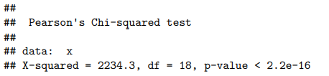
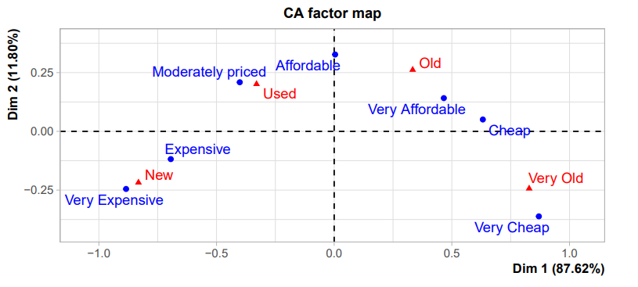
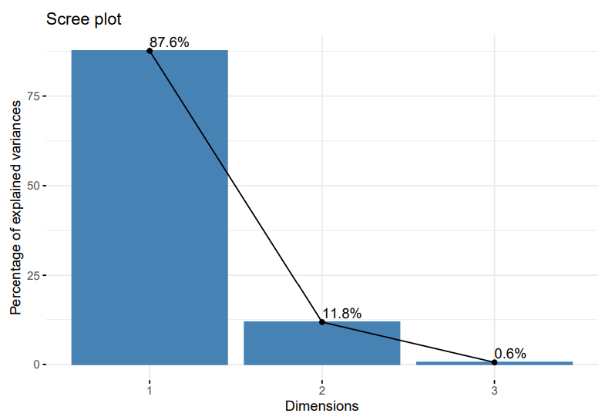
CA :
f.Price VS f.Mileage

Slide 14
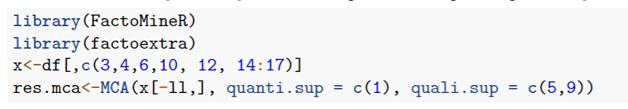
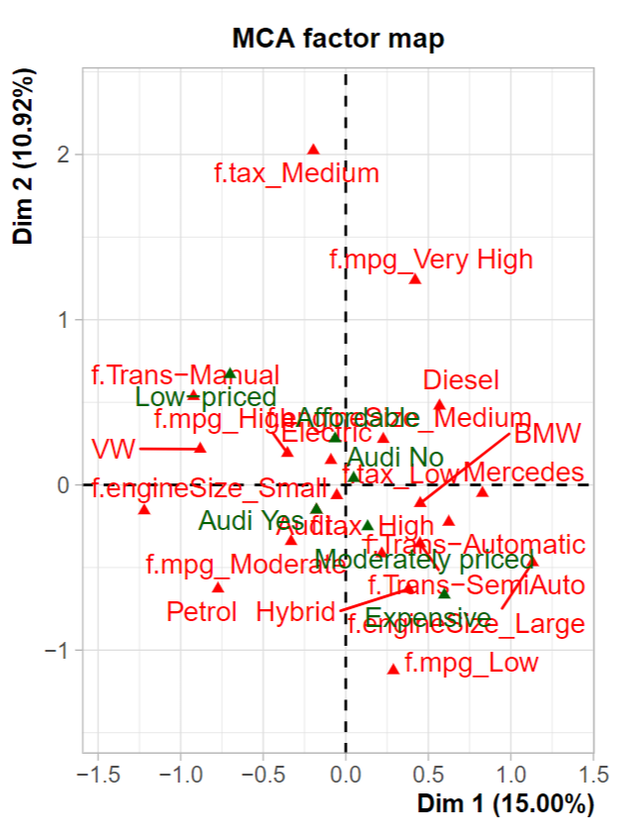
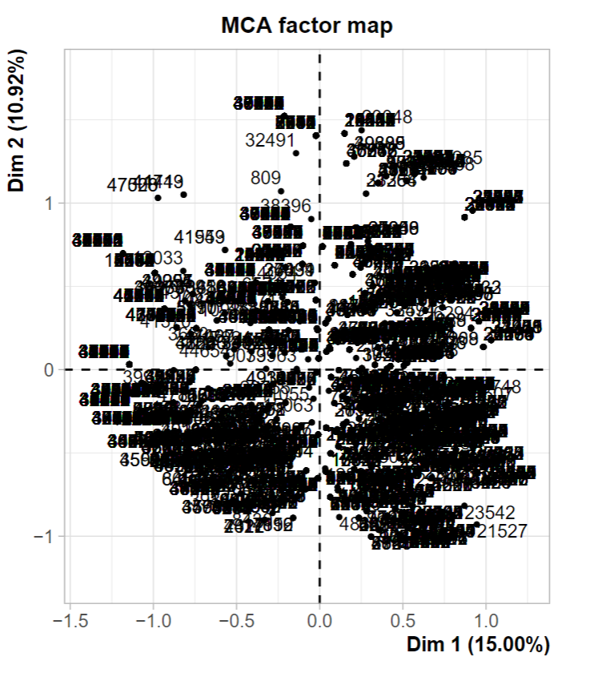
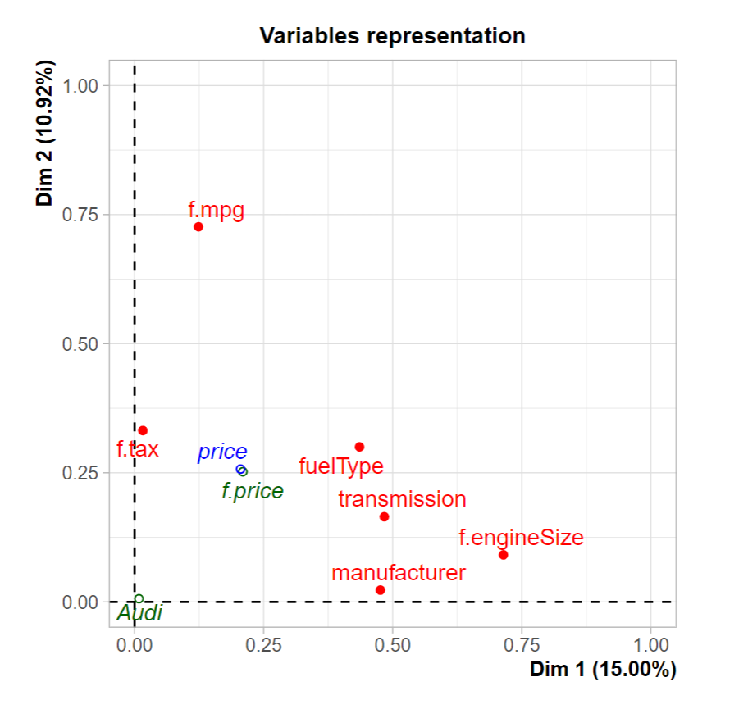
MCA

Slide 15
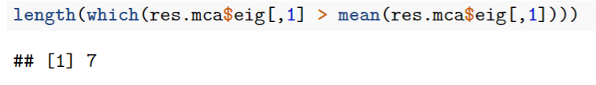
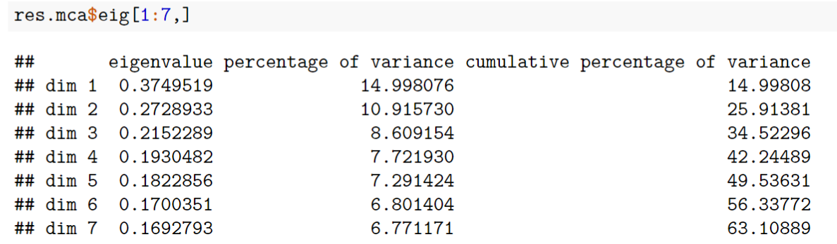
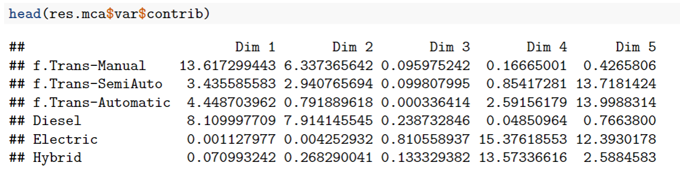

Slide 16
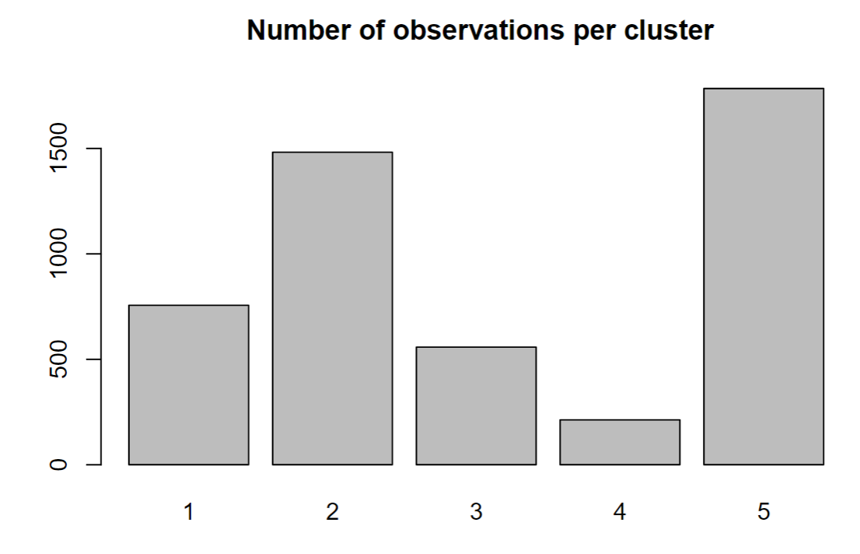
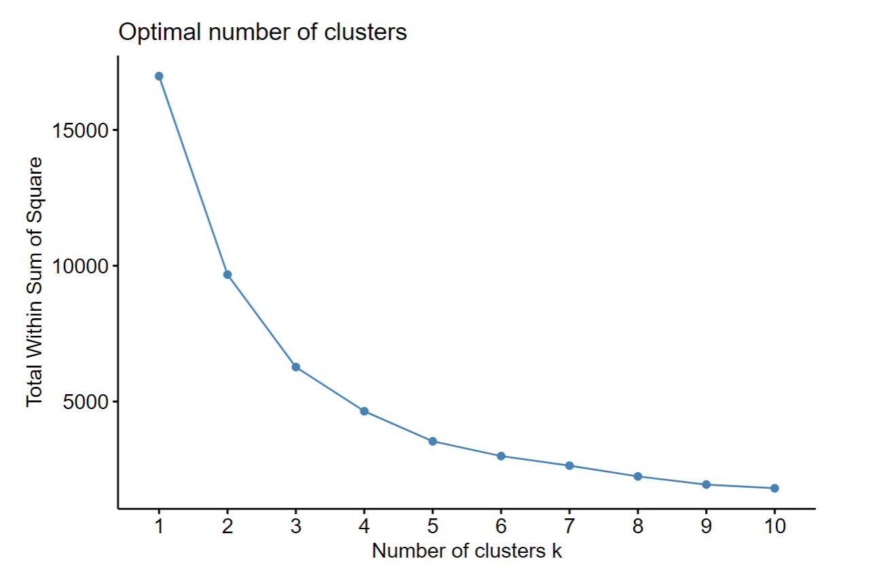
K-Means Clustering

Slide 17
Summary of clusters
Cluster 1
Non-Audi
newer cars (2019-2020),
low tax
medium-sized engines
predominantly diesel
Cluster 2
High mpg
Expensive
large engines
mostly petrol
Cluster 3
Low-tax
mixed engine sizes
predominantly diesel
Old
less expensive
High mpg
Cluster 4
Very old
low-priced vehicles,
mainly Mercedes and BMW
Cluster 5
High tax
very old models
large engines
low MPG

Slide 18
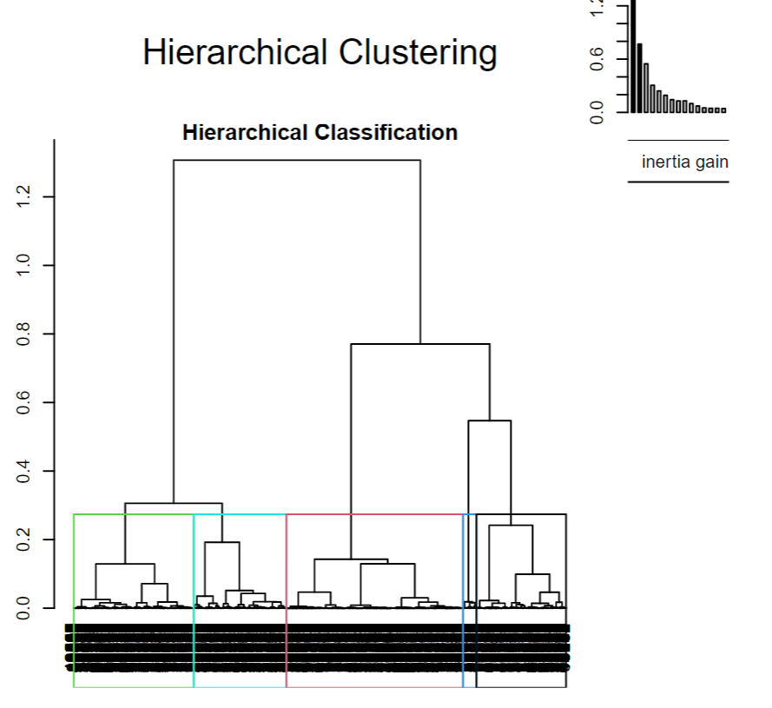
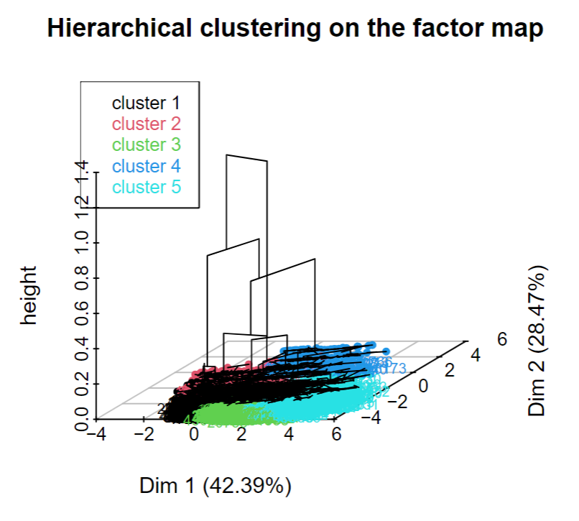
Hierarchical Clustering

Slide 19
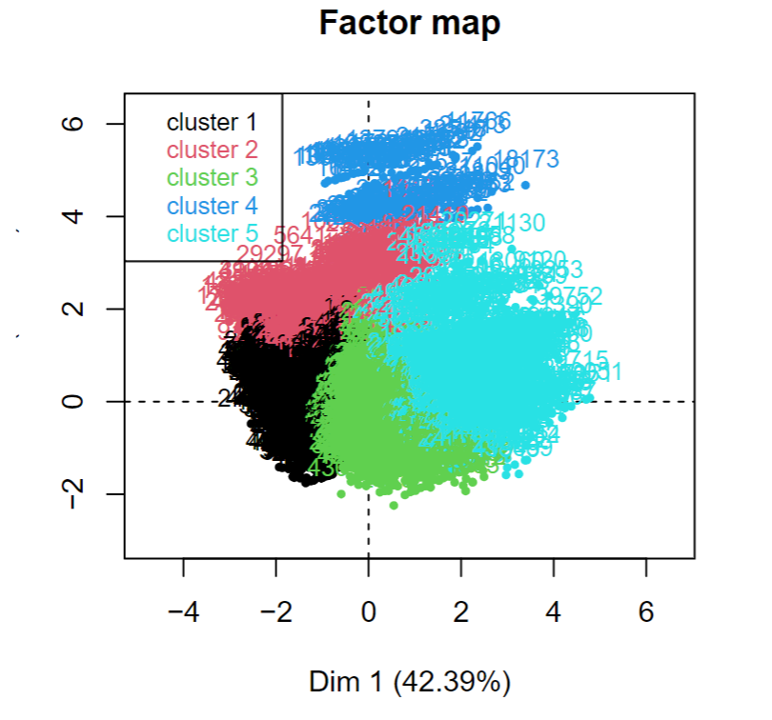
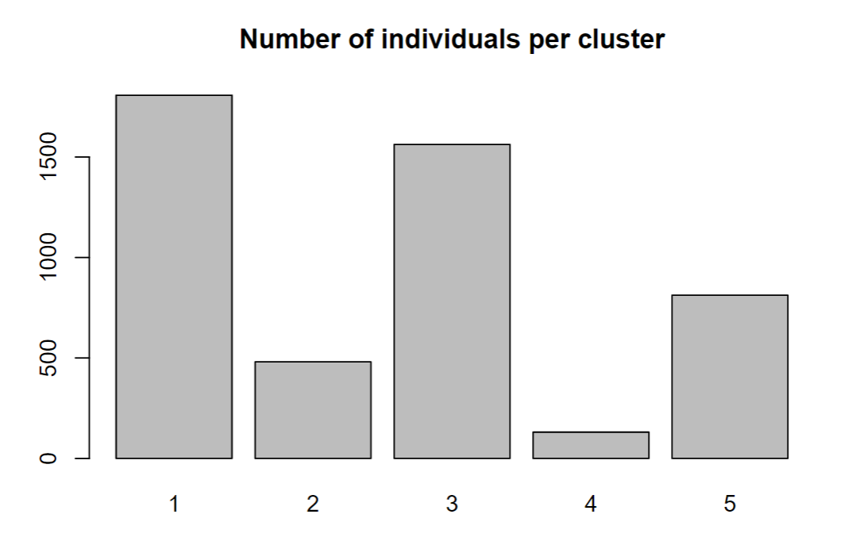

Slide 20
Summary of clusters
Cluster 1
new/nearly new
low mileage
Moderate mpg
expensive
Cluster 2
Large engines
Very expensive.
Cluster 3
Older vehicles
high mileage
Low fuel efficiency
affordable
Cluster 4
High tax
Very expensive cars
moderate MPG
Old
large engines
Cluster 5
Very old
Low-priced
high tax
Diesel
high MPG
manual transmission

Slide 21
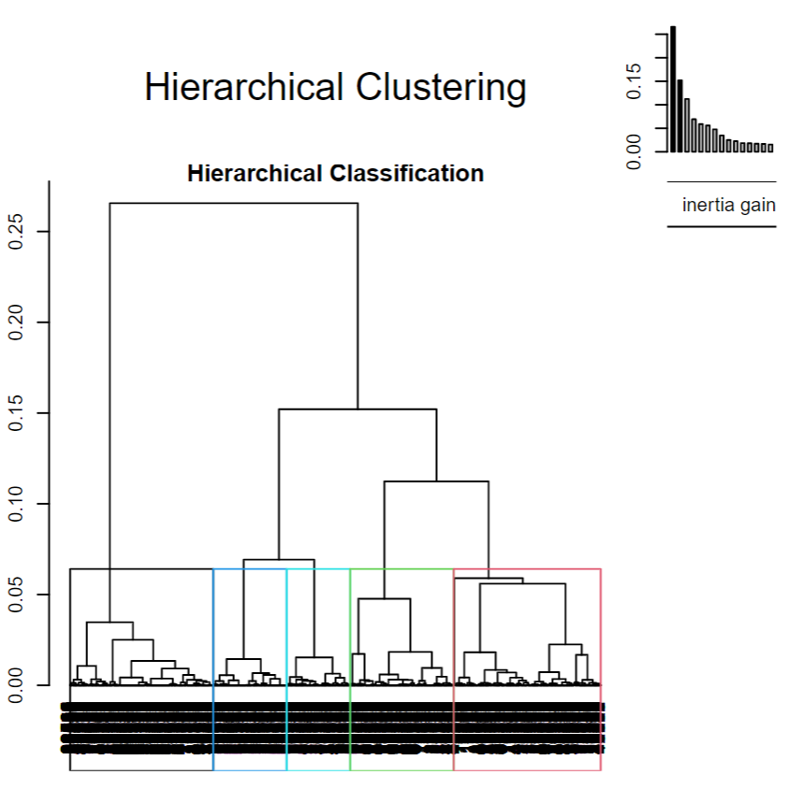
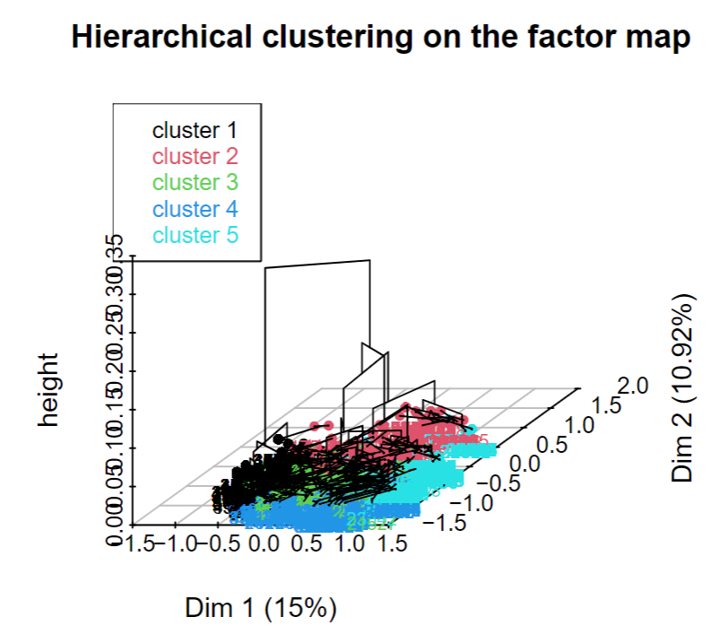
Hierarchical Clustering from MCA

Slide 22
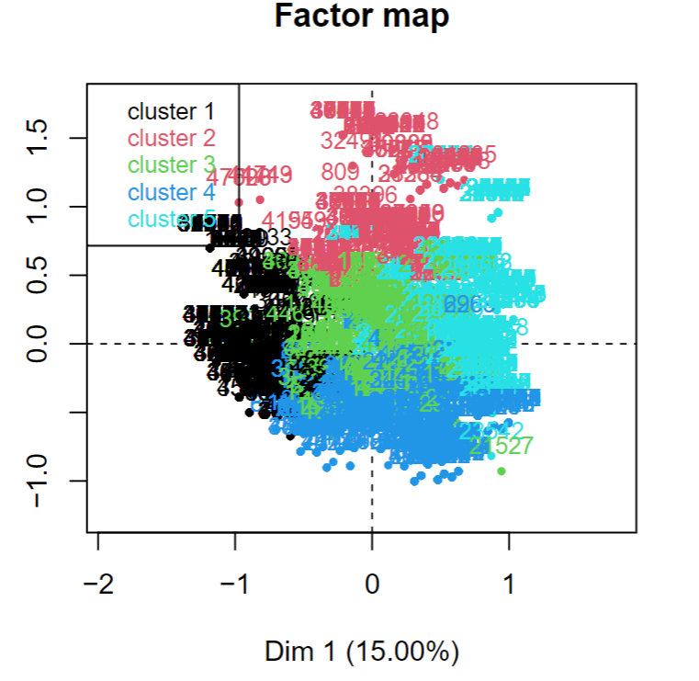
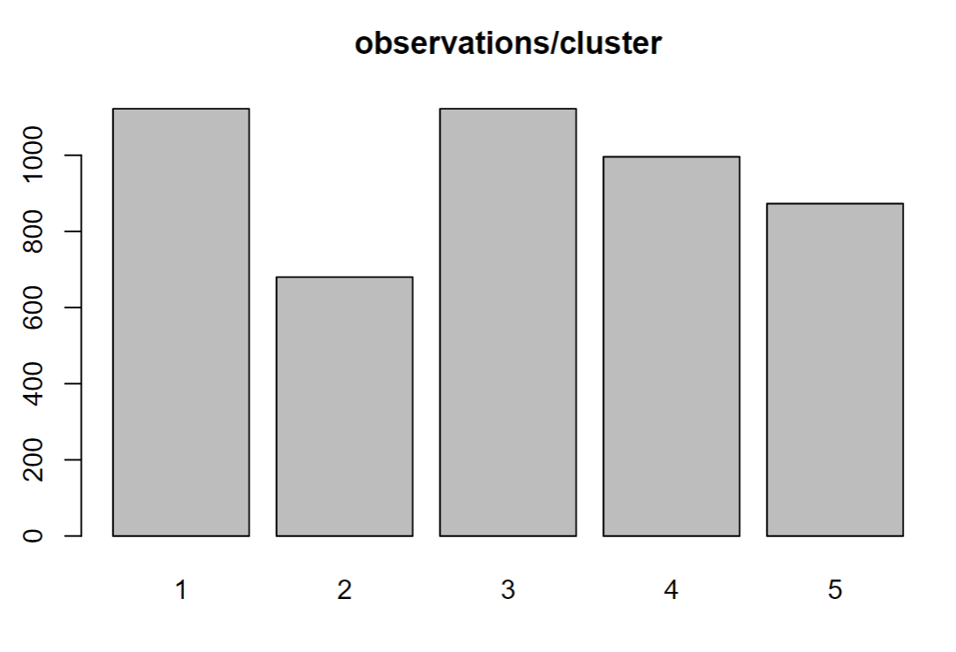

Slide 23
Summary of clusters
Cluster 1
Small engine sizes
Petrol
manual transmission
Volkswagen dominant
high MPG
very cheap
low tax
Cluster 2
Medium-sized engines
Diesel
BMW dominant
Hybrid
manual transmission
high tax
Cluster 3
Medium tax
very high MPG
diesel
affordable or cheap
Manual transmission
medium-size engines
Cluster 4
Low MPG
very expensive
large engines
Petrol
high tax
automatic transmission
Audi prominent.
Cluster 5
diesel
large engines
medium -low taxes
very high MPG
automatic/semi-automatic transmissions

Slide 24
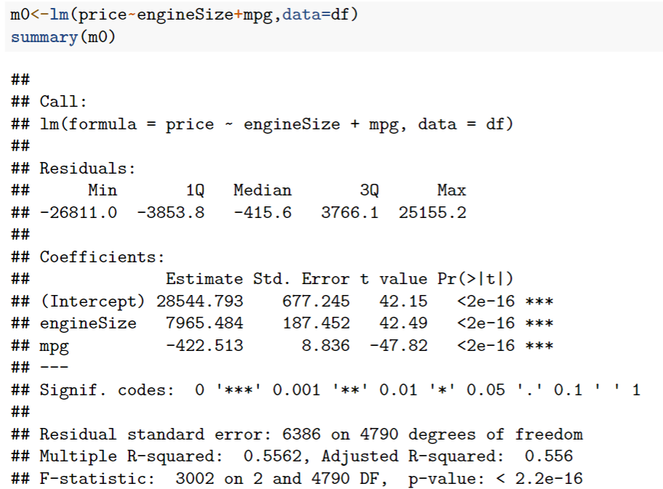
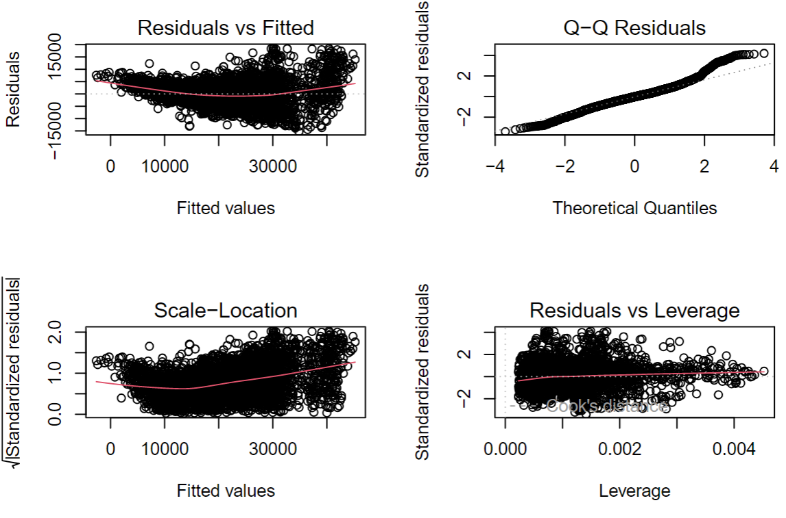
Predictive Modeling
numeric target - linear regression

Slide 25
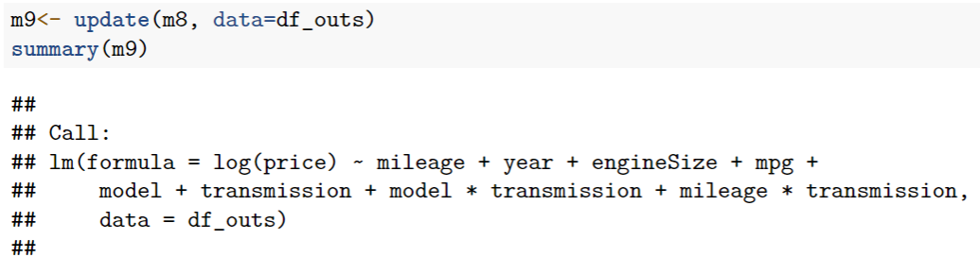
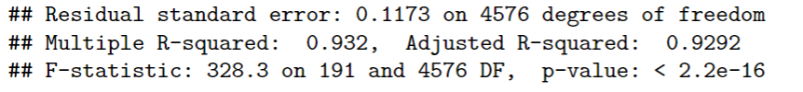


Slide 26


Predictive Modeling
Binary target - Audi?

Slide 27





Slide 28




Predictive Power
Model’s Overall Accuracy
How well the model is at correctly identifying?
How well the model is at correctly identifying positive instances?
The model shows stronger predictive accuracy for non-Audi vehicles than for Audi cars.

Slide 29
Thanks!
Any questions ?

